Slide 1

Chapter 4
Conditionals and Loops

Slide 2
Chapter Scope
Flow of control
Boolean expressions
if and switch statements
Comparing data
while, do, and for loops
Iterators

Slide 3
Flow of Control
Statement execution is linear unless specified otherwise
Some programming statements allow us to:
decide whether or not to execute a particular statement
execute a statement over and over, repetitively
These decisions are based on boolean expressions (or conditions) that evaluate to true or false
The order of statement execution is called the flow of control

Slide 4
Loops
Repetition statements allow us to execute a statement multiple times
Often they are referred to as loops
Like conditional statements, they are controlled by boolean expressions
Java has three kinds of repetition statements:
the while loop
the do loop
the for loop
The programmer should choose the right kind of loop for the situation

Slide 5
The while Loop
A while loop has the following syntax
If the condition is true, the statement is executed
Then the condition is evaluated again, and if it is still true, the statement is executed again
The statement is executed repeatedly until the condition becomes false
while ( condition )
statement;

Slide 6
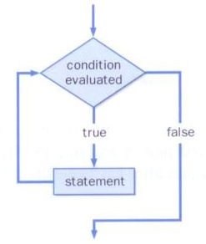
The while Loop
The logic of a while loop:

Slide 7
The while Loop
Example:
int count = 1;
while (count <= 5)
{
System.out.println (count);
count++;
}
If the condition of a while loop is false initially, the statement is never executed
Therefore, the body of a while loop will execute zero or more times

Slide 8
The while Loop
Let's look at some examples of loop processing
A loop can be used to maintain a running sum
A sentinel value is a special input value that represents the end of input

Slide 9
//********************************************************************
// Average.java Java Foundations
//
// Demonstrates the use of a while loop, a sentinel value, and a
// running sum.
//********************************************************************
import java.text.DecimalFormat;
import java.util.Scanner;
public class Average
{
//-----------------------------------------------------------------
// Computes the average of a set of values entered by the user.
// The running sum is printed as the numbers are entered.
//-----------------------------------------------------------------
public static void main(String[] args)
{
int sum = 0, value, count = 0;
double average;
Scanner scan = new Scanner(System.in);
System.out.print("Enter an integer (0 to quit): ");
value = scan.nextInt();

Slide 10
while (value != 0) // sentinel value of 0 to terminate loop
{
count++;
sum += value;
System.out.println("The sum so far is " + sum);
System.out.print("Enter an integer (0 to quit): ");
value = scan.nextInt();
}
System.out.println();
if (count == 0)
System.out.println("No values were entered.");
else
{
average = (double)sum / count;
DecimalFormat fmt = new DecimalFormat("0.###");
System.out.println("The average is " + fmt.format(average));
}
}
}

Slide 11
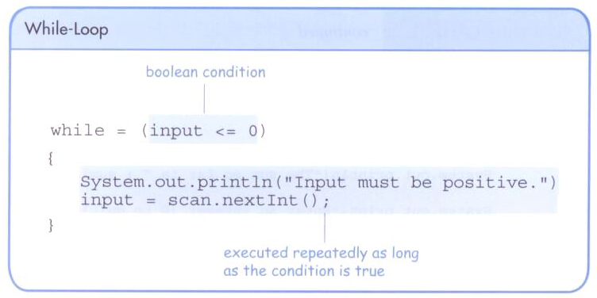
The while Loop
A loop can also be used for input validation, making a program more robust

Slide 12
//********************************************************************
// WinPercentage.java Java Foundations
//
// Demonstrates the use of a while loop for input validation.
//********************************************************************
import java.text.NumberFormat;
import java.util.Scanner;
public class WinPercentage
{
//-----------------------------------------------------------------
// Computes the percentage of games won by a team.
//-----------------------------------------------------------------
public static void main(String[] args)
{
final int NUM_GAMES = 12;
int won;
double ratio;
Scanner scan = new Scanner(System.in);
System.out.print("Enter the number of games won (0 to "
+ NUM_GAMES + "): ");
won = scan.nextInt();

Slide 13
while (won < 0 || won > NUM_GAMES)
{
System.out.print("Invalid input. Please reenter: ");
won = scan.nextInt();
}
ratio = (double)won / NUM_GAMES;
NumberFormat fmt = NumberFormat.getPercentInstance();
System.out.println();
System.out.println("Winning percentage: " + fmt.format(ratio));
}
}

Slide 14
Infinite Loops
The body of a loop eventually must make the condition false
If not, it is called an infinite loop, which will execute until the user interrupts the program
This is a common logical error
You should double check the logic of a program to ensure that your loops will terminate normally

Slide 15
Infinite Loops
An example of an infinite loop:
int count = 1;
while (count <= 25)
{
System.out.println (count);
count = count - 1;
}
This loop will continue executing until interrupted (Control-C) or until an underflow error occurs

Slide 16
Nested Loops
Similar to nested if statements, loops can be nested as well
That is, the body of a loop can contain another loop
For each iteration of the outer loop, the inner loop iterates completely

Slide 17
Nested Loops
How many times will the output be printed?
count1 = 1;
while (count1 <= 10)
{
count2 = 1;
while (count2 <= 50)
{
System.out.println ("Here again");
count2++;
}
count1++;
}

Slide 18
//********************************************************************
// PalindromeTester.java Java Foundations
//
// Demonstrates the use of nested while loops.
//********************************************************************
import java.util.Scanner;
public class PalindromeTester
{
//-----------------------------------------------------------------
// Tests strings to see if they are palindromes.
//-----------------------------------------------------------------
public static void main(String[] args)
{
String str, another = "y";
int left, right;
Scanner scan = new Scanner(System.in);
while (another.equalsIgnoreCase("y")) // allows y or Y
{
System.out.println("Enter a potential palindrome:");
str = scan.nextLine();
left = 0;
right = str.length() - 1;

Slide 19
while (str.charAt(left) == str.charAt(right) && left < right)
{
left++;
right--;
}
System.out.println();
if (left < right)
System.out.println("That string is NOT a palindrome.");
else
System.out.println("That string IS a palindrome.");
System.out.println();
System.out.print("Test another palindrome (y/n)? ");
another = scan.nextLine();
}
}
}

Slide 20
Iterators
An iterator is an object that allows you to process a collection of items one at a time
It lets you step through each item in turn and process it as needed
An iterator object has a hasNext method that returns true if there is at least one more item to process
The next method returns the next item
Iterator objects are defined using the Iterator interface, which is discussed further in Chapter 9

Slide 21
Iterators
Some classes in the Java API are iterators
The Scanner class is an iterator
the hasNext method returns true if there is more data to be scanned
the next method returns the next scanned token as a string
The Scanner class also has variations on the hasNext method for specific data types (such as hasNextInt)

Slide 22
Iterators
The fact that a Scanner is an iterator is particularly helpful when reading input from a file
Suppose we wanted to read and process a list of URLs stored in a file
One scanner can be set up to read each line of the input until the end of the file is encountered
Another scanner can be set up for each URL to process each part of the path

Slide 23
//********************************************************************
// URLDissector.java Java Foundations
//
// Demonstrates the use of Scanner to read file input and parse it
// using alternative delimiters.
//********************************************************************
import java.util.Scanner;
import java.io.*;
public class URLDissector
{
//-----------------------------------------------------------------
// Reads urls from a file and prints their path components.
//-----------------------------------------------------------------
public static void main(String[] args) throws IOException
{
String url;
Scanner fileScan, urlScan;
fileScan = new Scanner(new File("websites.inp"));
// Read and process each line of the file
while (fileScan.hasNext())
{
url = fileScan.nextLine();
System.out.println("URL: " + url);

Slide 24
urlScan = new Scanner(url);
urlScan.useDelimiter("/");
// Print each part of the url
while (urlScan.hasNext())
System.out.println(" " + urlScan.next());
System.out.println();
}
}
}

Slide 25
The do Loop
The do loop has the following syntax:
The statement is executed once initially, and then the condition is evaluated
The statement is executed repeatedly until the condition becomes false
do
{
statement;
}
while ( condition )

Slide 26
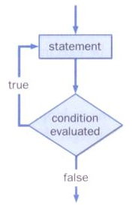
The do Loop
The logic of a do loop:

Slide 27
The do Loop
An example of a do loop:
int count = 0;
do
{
count++;
System.out.println (count);
} while (count < 5);
The body of a do loop is executed at least once

Slide 28
//********************************************************************
// ReverseNumber.java Java Foundations
//
// Demonstrates the use of a do loop.
//********************************************************************
import java.util.Scanner;
public class ReverseNumber
{
//-----------------------------------------------------------------
// Reverses the digits of an integer mathematically.
//-----------------------------------------------------------------
public static void main(String[] args)
{
int number, lastDigit, reverse = 0;
Scanner scan = new Scanner(System.in);
System.out.print("Enter a positive integer: ");
number = scan.nextInt();

Slide 29
do
{
lastDigit = number % 10;
reverse = (reverse * 10) + lastDigit;
number = number / 10;
}
while (number > 0);
System.out.println("That number reversed is " + reverse);
}
}

Slide 30
Comparing while and do Loops

Slide 31
The for Loop
The for loop has the following syntax:
The initialization
is executed once
before the loop begins
The statement is
executed until the
condition becomes false
for ( initialization ; condition ; increment )
statement;
The increment portion is executed at the end of each iteration

Slide 32
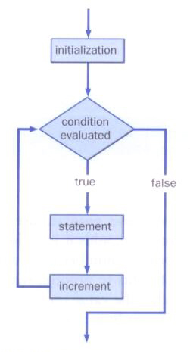
The for Loop
The logic of a for loop:

Slide 33
The for Loop
A for loop is functionally equivalent to the following while loop structure:
initialization;
while ( condition )
{
statement;
increment;
}

Slide 34
The for Loop
An example of a for loop:
for (int count=1; count <= 5; count++)
System.out.println (count);
The initialization section can be used to declare a variable
Like a while loop, the condition of a for loop is tested prior to executing the loop body
Therefore, the body of a for loop will execute zero or more times

Slide 35
The for Loop
The increment section can perform any calculation
for (int num=100; num > 0; num -= 5)
System.out.println (num);
A for loop is well suited for executing statements a specific number of times that can be calculated or determined in advance

Slide 36
//********************************************************************
// Multiples.java Java Foundations
//
// Demonstrates the use of a for loop.
//********************************************************************
import java.util.Scanner;
public class Multiples
{
//-----------------------------------------------------------------
// Prints multiples of a user-specified number up to a user-
// specified limit.
//-----------------------------------------------------------------
public static void main(String[] args)
{
final int PER_LINE = 5;
int value, limit, mult, count = 0;
Scanner scan = new Scanner(System.in);
System.out.print("Enter a positive value: ");
value = scan.nextInt();
System.out.print("Enter an upper limit: ");
limit = scan.nextInt();

Slide 37
System.out.println();
System.out.println("The multiples of " + value + " between " +
value + " and " + limit + " (inclusive) are:");
for (mult = value; mult <= limit; mult += value)
{
System.out.print(mult + "\t");
// Print a specific number of values per line of output
count++;
if (count % PER_LINE == 0)
System.out.println();
}
}
}

Slide 38
//********************************************************************
// Stars.java Java Foundations
//
// Demonstrates the use of nested for loops.
//********************************************************************
public class Stars
{
//-----------------------------------------------------------------
// Prints a triangle shape using asterisk (star) characters.
//-----------------------------------------------------------------
public static void main(String[] args)
{
final int MAX_ROWS = 10;
for (int row = 1; row <= MAX_ROWS; row++)
{
for (int star = 1; star <= row; star++)
System.out.print("*");
System.out.println();
}
}
}

Slide 39
The for Loop
Each expression in the header of a for loop is optional
If the initialization is left out, no initialization is performed
If the condition is left out, it is always considered to be true, and therefore creates an infinite loop
If the increment is left out, no increment operation is performed

Slide 40
Iterators and for Loops
A variant of the for loop simplifies the repetitive processing for any object that implements the Iterable interface
An Iterable interface provides an iterator
For example, if BookList is an Iterable object that manages Book objects, the following loop will print each book:
for (Book myBook : BookList)
System.out.println (myBook);

Slide 41
The for-each Loop
This style of for loop can be read "for each Book in BookList, …"
This version is sometimes referred to as the for-each loop
It eliminates the need to call the hasNext and next methods explicitly
It also will be helpful when processing arrays, which are discussed in Chapter 7

